Slide 1
Django-App part -3
Django mastery course

Slide 2
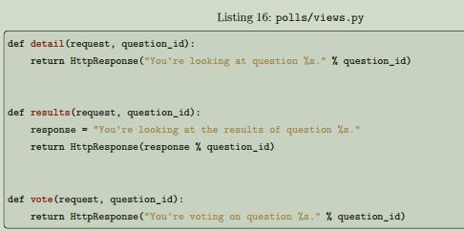
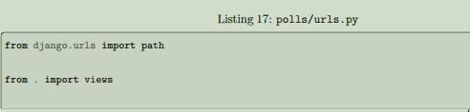
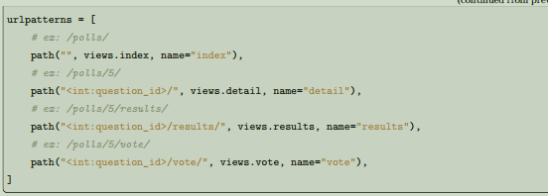
Overview
A view is a “type” of web page in your Django application that generally serves a specific function and has a
specific template. For example, in a blog application, you might have the following views:
• Blog homepage – displays the latest few entries.
• Entry “detail” page – permalink page for a single entry.
• Year-based archive page – displays all months with entries in the given year.
• Month-based archive page – displays all days with entries in the given month.
• Day-based archive page – displays all entries in the given day.
• Comment action – handles posting comments to a given entry.
In our poll application, we’ll have the following four views:
• Question “index” page – displays the latest few questions.
• Question “detail” page – displays a question text, with no results but with a form to vote.
• Question “results” page – displays results for a particular question.
• Vote action – handles voting for a particular choice in a particular question.
In Django, web pages and other content are delivered by views. Each view is represented by a Python function (or method, in the case of class-based views). Django will choose a view by examining the URL that’s
requested (to be precise, the part of the URL after the domain name). To get from a URL to a view, Django uses what are known as ‘URL confs’. A URL conf maps URL patterns to
views.

Slide 3
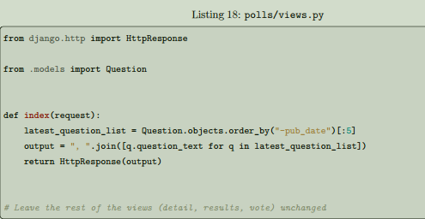
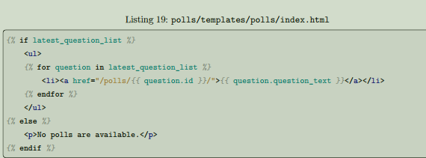
Write views that actually do something
Each view is responsible for doing one of two things: returning an Http-Response object containing the content for the requested page , or raising an exception such as Http404. The rest is up to you.Your view can read records from a database, or not. It can use a template system such as Django’s – or a third-party Python template system – or not. It can generate a PDF file, output XML, create a ZIP file on the fly, anything you want, using whatever Python libraries you want. All Django wants is that HttpResponse. Or an exception.Because it’s convenient, let’s use Django’s own database API, which we covered in Tutorial 2. Here’s one stab at a new index() view, which displays the latest 5 poll questions in the system, separated by commas, according to publication date:
Creating Templates
Your project’s TEMPLATES setting describes how Django will load and render templates. The default settings file configures a Djang-Templates backend whose APP_DIRS option is set to True. By convention
DjangoTemplates looks for a “templates” subdirectory in each of the INSTALLED_APPS.
Within the templates directory you have just created, create another directory called polls, and within that create a file called index.html. In other words, your template should be at polls/templates/polls/index.
html. Because of how the app_directories template loader works as described above, you can refer to this template within Django as polls/index.html

Slide 4
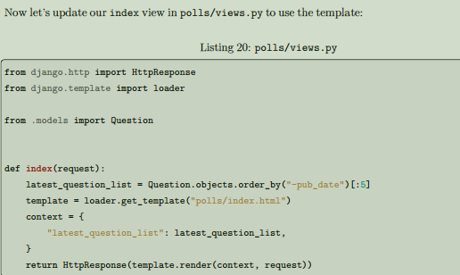
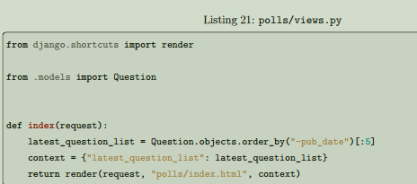
A shortcut: render()
It’s a very common idiom to load a template, fill a context and return an HttpResponse object with the result of the rendered template. Django provides a shortcut. Here’s the full index() view, rewritten:
That code loads the template called polls/index.html and passes it a context. The context is a dictionary mapping template variable names to Python objects.
Note that once we’ve done this in all these views, we no longer need to import loader and HttpResponse
(you’ll want to keep HttpResponse if you still have the stub methods for detail, results, and vote).
The render() function takes the request object as its first argument, a template name as its second argument and a dictionary as its optional third argument. It returns an HttpResponse object of the given template
rendered with the given context

Slide 5
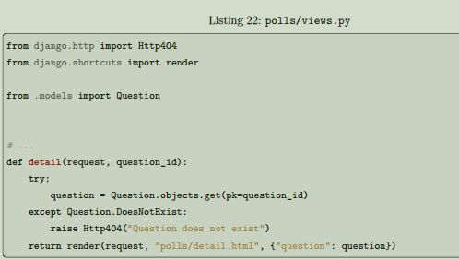
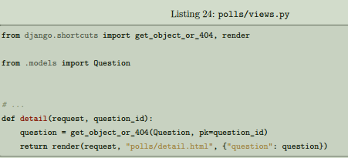

A shortcut: get_object_or_404()
It’s a very common idiom to use get() and raise Http404 if the object doesn’t exist. Django provides a
shortcut. Here’s the detail() view, rewritten:
The get_object_or_404() function takes a Django model as its first argument and an arbitrary number of keyword arguments, which it passes to the get() function of the model’s manager. It raises Http404 if the
object doesn’t exist.
Raising a 404 error
Now, let’s tackle the question detail view – the page that displays the question text for a given poll. Here’s the view:
The new concept here: The view raises the Http404 exception if a question with the requested ID doesn’t exist. We’ll discuss what you could put in that polls/detail.html template a bit later, but if you’d like to quickly get the above example working, a file containing just:

Slide 6
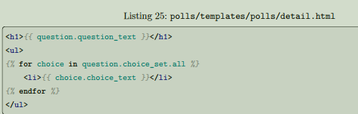

Use the template system
Back to the detail() view for our poll application. Given the context variable question, here’s what the polls/detail.html template might look like:
The template system uses dot-lookup syntax to access variable attributes. In the example of {{ question.question_text }}, first Django does a dictionary lookup on the object question. Failing that, it tries an attribute lookup – which works, in this case. If attribute lookup had failed, it would’ve tried a list-index lookup.
Method-calling happens in the {% for %} loop: question.choice_set.all is interpreted as the Python code
question.choice_set.all(), which returns an iterable of Choice objects and is suitable for use in the {%for %} tag.
Removing hardcoded URLs in templates
Remember, when we wrote the link to a question in the polls/index.html template, the link was partially
hardcoded like this:
<li><a href="/polls/{{ question.id }}/">{{ question.question_text }}</a></li>
The problem with this hardcoded, tightly-coupled approach is that it becomes challenging to change URLs
on projects with a lot of templates. However, since you defined the name argument in the path() functions in
the polls.urls module, you can remove a reliance on specific URL paths defined in your url configurations
by using the {% url %} template tag:
<li><a href="{% url 'detail' question.id %}">{{ question.question_text }}</a></li>
The way this works is by looking up the URL definition as specified in the polls.urls module. You can see
exactly where the URL name of ‘detail’ is defined below:

Slide 7
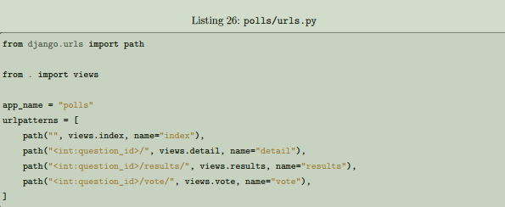

Namespacing URL names
The tutorial project has just one app, polls. In real Django projects, there might be five, ten, twenty apps or more. How does Django differentiate the URL names between them? For example, the polls app has a detail view, and so might an app on the same project that is for a blog. How does one make it so that Django knows which app view to create for a url when using the {% url %} template tag? The answer is to add namespaces to your URLconf. In the polls/urls.py file, go ahead and add an app_name to set the application namespace:

Slide 8

Thank you for watching
💖

